Slide 1

COMP1516
Lesson 5: Lists

Slide 2
Topics
Containers
Tuples
Tuple: multiple return from function
Lists
Lists and loops
List functions and methods
Lists of lists
List Comprehensions
Mutable Operations

Slide 3
Containers
In python, related data can be grouped together into a single variable.
For example, instead of declaring one string variable to store the name of a single province, we could declare a container variable to store all of the names of all Canadian provinces.
There are four container types in python:
- tuple
- list
- set
- dictionary.
This lesson examines the first two: tuples and lists.

Slide 4
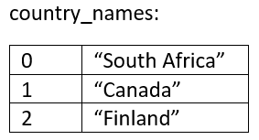
Tuples
A tuple contains an ordered sequence of elements (e.g. a bunch of strings for the names of the Canadian provinces).
Duplicate elements are allowed.
Elements are automatically given an index, beginning from zero.
Tuple elements cannot be added, removed, or updated once
declared (“immutable”).
Tuples use ( parentheses ).
Example:
provinces = () # empty tuple; very rare to do this
country_names = (“South Africa”, “Canada”, “Finland”)

Slide 5
Tuples: Functions and Methods
country_names = (“South Africa”, “Canada”, “Finland”)
[ Square brackets ] give access to individual elements in tuples.
print(country_names [1]) # Canada
print(country_names [3]) # Exception: IndexError
print(len(country_names )) # 3
car_makers = (“dodge”, “ford”, “honda”, “toyota”, “dodge”)
print(car_makers.count(“dodge”)) # 2; there are 2 instances of “dodge”
print(car_makers.count(“ford”)) # 1
print(car_makers.count(“lamborghini”)) # 0

Slide 6
Tuple: Multiple Return
Functions only permit one return value, but with a tuple we can actually return several values at once, inside of a single tuple.
def get_name_from_user():
first = input("What is your first name? ")
middle = input("What is your middle name? ")
last = input("What is your last name? ")
return (first, middle, last) # a tuple; notice the parentheses; returns ONE tuple containing MANY elements
full_name = get_name_from_user() # full_name is a tuple of three strings
print("Your full name is %s %s %s" % (full_name[0], full_name[1], full_name[2]))
OUTPUT:
What is your first name? tiger
What is your middle name? tont
What is your last name? woods
Your full name is tiger tont woods

Slide 7
Lists
A list is a mutable tuple.
If you do not want nor expect your container data to change, then use a tuple.
If you want or expect your container data to change, then use a list instead.
Tuples use ().
Lists use [].
Lists have more functions and methods than tuples, because elements can be removed, added, and updated: https://docs.python.org/3/tutorial/datastructures.html

Slide 8
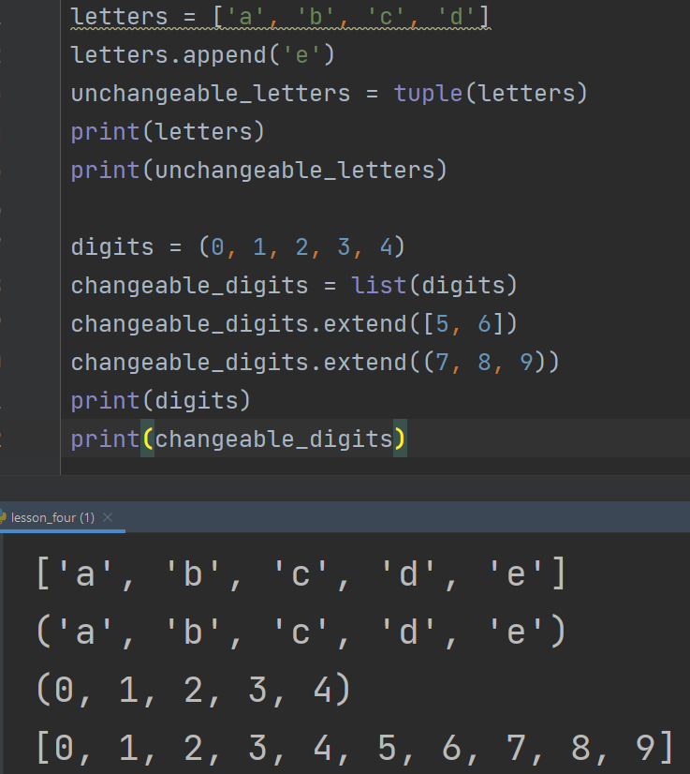
Lists and Tuples
There is a tuple() function that can create a tuple
(i.e. immutable) version of a list
There is also a list () function that can create a list
(i.e. mutable) version of a tuple

Slide 9
Lists and Functions and Methods
letters = []
letters = ["a", "b", "x", "y", "z"]
letters.pop() # removes the last element: z; could also do letters.pop(0) which removes the first element (here, ‘a’), etc…
letters.remove("y") # removes the first instance of y
letters[2] = "c" # the third element (x) is updated to become c
letters.append("d") # appended to the end of the list
letters.append("e")
letters.insert(0, ‘s’)
more_letters = ["f", "g", "h", "i", "j", "k"]
all_letters = letters + more_letters # joins together (“concatenates”) multiple lists with the plus + sign
print(all_letters) # ['s', 'a', 'b', 'c', 'd', 'e', 'f', 'g', 'h', 'i', 'j', 'k']

Slide 10
Lists and Loops
i = 0
while i < len(all_letters):
print("letter is %s\n" % all_letters[i])
i+=1
letter is a
letter is b
letter is c
letter is d
letter is e
letter is f
letter is g
letter is h
letter is I
letter is j
letter is k

Slide 11
List Functions and Methods
countries = [“japan”, “canada”, “china”, “mexico”, “england”, “greenland”]
print(min(countries)) # canada
print(max(countries)) # mexico
print(countries.index("england")) # 4
print(countries.count("iceland")) # 0 since it appears 0 times
print(countries.count("canada")) # 1 since it appears 1 time

Slide 12
Lists of Lists
row_0 = ["a", "b", "c", "d", "e", "f", "g", "h"]
row_1 = ["i", "j", "k", "l", "m", "n", "o", "p"]
row_2 = ["q", "r", "s", "t", "u", "v", "w", "x"]
row_3 = ["y", "z"]
table = [row_0,
row_1,
row_2,
row_3]
number_of_rows = len(table)
i = 0
while i < number_of_rows:
print("Row %d" % (i), end=':: ‘)
number_of_letters_in_this_row = len(table[i])
j = 0
while j < number_of_letters_in_this_row:
print((table[i][j]), end=' ‘)
j+=1
print()
i+=1
Row 0:: a b c d e f g h
Row 1:: i j k l m n o p
Row 2:: q r s t u v w x
Row 3:: y z

Slide 13
List Comprehensions
A list comprehension is a shorter way to create a new list, from another list, based upon conditions that you set.
countries = [“south africa", “canada", “mexico", “finland", “sweden", “chad"]
countries_with_e = [country for country in countries if "e" in country]
# countries_with_e = [x for x in countries if "e" in x]
print(countries_with_e) # ['mexico', 'sweden']
Here, each element of provinces takes a turn becoming the new variable called “country”. If that element contains the letter e, it is appended to the new list countries_with_e.

Slide 14
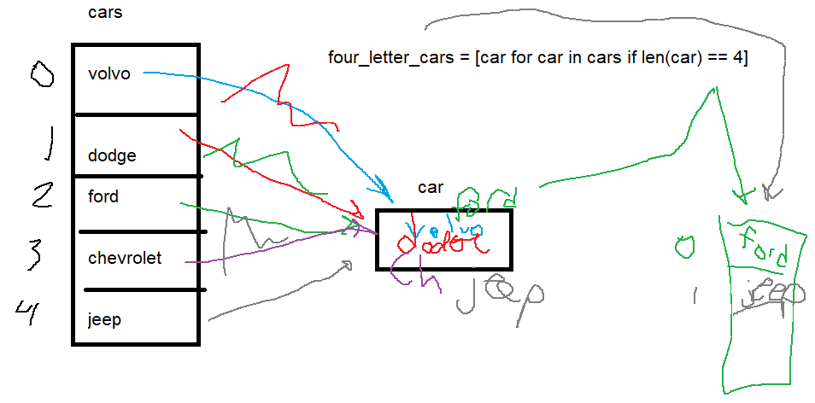
List Comprehensions

Slide 15
List: Mutable Operations
# 0 1 2 3 4 5 6 7
sports = ['football', 'ice hockey', 'basketball', 'baseball', 'wrestling', 'running', 'tennis', 'golf']
some_sports= sports[3:6] # from 3 to 5 (not 6!)
print(some_sports) # 'baseball', 'wrestling', 'running'
del sports[1] # ice hockey is deleted
print(sports) # ['football', 'basketball', 'baseball', 'wrestling', 'running', 'tennis', 'golf’]

Slide 16
List: Mutable Operations
letters = ['a', 'b', 'c', 'd', 'e', 'f', 'g', 'h', 'i', 'j', 'k']
letters.extend(['l', 'm', 'n']) # abcdefghijklmn
letters.insert(1, 'w') # awbcdefghijklmn
removed_letter = letters.pop(-2) # m
letters.sort() # abcdefghijklnw m is gone
letters.reverse() # wmlkjihgfedcba

